Slide 1
Database System
Lecture 3
Introduction
Alina Arshad
alina.arshad@nu.edu.pk
Basement 2 Room#4

Slide 2
Users
A user of a database system will:
Use a database application to track things
Use forms to enter, read, delete, and query data
Produce reports

Slide 3
Database Users
Users may be divided into
Those who actually use and control the database content, and those who design, develop and maintain database applications (called “Actors on the Scene”), and
Those who design and develop the DBMS software and related tools, and the computer systems operators (called “Workers Behind the Scene”).

Slide 4
Database Users – Actors on the Scene
Actors on the scene
Database administrators:
Responsible for authorizing access to the database, for coordinating and monitoring its use, acquiring software and hardware resources, controlling its use and monitoring efficiency of operations.
Database Designers:
Responsible to define the content, the structure, the constraints, and functions or transactions against the database. They must communicate with the end-users and understand their needs.

Slide 5
Database End Users
Actors on the scene (continued)
End-users: They use the data for queries, reports and some of them update the database content. End-users can be categorized into:
Naïve or Parametric: they make up a large section of the end-user population.
They use previously well-defined functions in the form of “canned transactions” against the database.
Users of Mobile Apps mostly fall in this category
Bank-tellers or reservation clerks are parametric users who do this activity for an entire shift of operations.
Social Media Users post and read information from websites
Casual: access database occasionally when needed.

Slide 6
Database End Users (continued)
Sophisticated:
These include business analysts, scientists, engineers, others thoroughly familiar with the system capabilities.
Many use tools in the form of software packages that work closely with the stored database.
Stand-alone:
Mostly maintain personal databases using ready-to-use packaged applications.
An example is the user of a tax program that creates its own internal database.
Another example is a user that maintains a database of personal photos and videos.

Slide 7
Database Users – Actors on the Scene (continued)
System Analysts and Application Developers
This category currently accounts for a very large proportion of the IT work force.
System Analysts: They understand the user requirements of naïve and sophisticated users and design applications including canned transactions to meet those requirements.
Application Programmers: Implement the specifications developed by analysts and test and debug them before deployment.
Business Analysts: There is an increasing need for such people who can analyze vast amounts of business data and real-time data (“Big Data”) for better decision making related to planning, advertising, marketing etc.

Slide 8
Database Users – Actors behind the Scene
System Designers and Implementors: Design and implement DBMS packages in the form of modules and interfaces and test and debug them. The DBMS must interface with applications, language compilers, operating system components, etc.
Tool Developers: Design and implement software systems called tools for modeling and designing databases, performance monitoring, prototyping, test data generation, user interface creation, simulation etc. that facilitate building of applications and allow using database effectively.
Operators and Maintenance Personnel: They manage the actual running and maintenance of the database system hardware and software environment.

Slide 9
Advantages of using DBMS
Controlling Redundancy
Duplication of efforts.
Storage space is wasted when the same data is stored repeatedly.
Inconsistency: files that represent the same data may become inconsistent. This may happen because an update is applied to some of the files but not to others
Restricting Unauthorized Access
Using particular accounts protected by password
For example, financial data such as salaries and bonuses is often considered confidential, and only authorized persons are allowed to access such data.
Notes:
When multiple users share a large database, it is likely that most users will not beauthorized to access all information in the database.

Slide 10
Advantages of using DBMS
Providing Persistent Storage for Program Objects.
Providing Storage Structures and Search Techniques for Efficient Query Processing.
Data buffering or caching: DBMSs do their own data buffering.
Query processing and optimization module: responsible for choosing an efficient query execution plan for each query based on the existing storage structures.

Slide 11
Advantages of using DBMS
Providing Backup and Recovery
Providing Multiple User Interfaces
Query languages for casual users
Programming language interfaces for application programmers
Forms and command codes for parametric users
Menu-driven interfaces
Natural language interfaces for standalone users.
Representing Complex Relationships among Data
Enforcing Integrity Constraints.
Notes:
For example, if the computer system fails in the middle of a complex update transaction, the recovery subsystem is responsible for making sure that the database is
restored to the state it was in before the transaction started executing. Disk backup is also necessary in case of a catastrophic disk failure.

Slide 12
Additional Implications of Using the Database Approach
Potential for Enforcing Standards.
Standards can be defined for names and formats of data elements, display formats, report structures, terminology, and so on.
Reduced Application Development Time
once a database is up and running, substantially less time is generally required to create new applications.
Flexibility to change the structure of a database as requirements change.
Notes:
Names and Formats of Data Elements: For instance, ensuring that all customer names follow the same format (e.g., first name followed by last name) or that dates are consistently formatted (e.g., DD/MM/YYYY).
Display Formats: Ensuring that data is presented in a uniform way across all applications, such as consistent currency symbols or decimal places in financial reports.
Report Structures: Standardizing how information is organized and presented in reports, making it easier to compare and analyze data across different parts of the organization
Terminology: Ensuring that all departments use the same terms and definitions for key data elements. For example, "client" vs. "customer" should be consistently used across the board.

Slide 13
Additional Implications of Using the Database Approach
Availability of Up-to-Date Information
Reservation systems
Banking databases, and it is made possible by the concurrency control and recovery subsystems of a DBMS
Economies of Scale
Combining all the organization’s operational data into one database and creating a set of applications that work on this one source of data can result in cost savings.

Slide 14
When Not To Use DBMS
No multiple-user access to data.
Embedded systems with limited storage capacity, where a general-purpose DBMS would not fit.
Stringent, real-time requirements for some application programs that may not be met because of DBMS overhead.
i.e., telephone switching systems
Simple, well-defined database applications that are not expected to change at all.
Notes:
An embedded system is a microprocessor-based computer hardware system with software that is designed to perform a dedicated function, either as an independent system or as a part of a large system. ... Embedded system applications range from digital watches and microwaves to hybrid vehicles and avionics.
Certain industries and application have elected not to use general purpose DBMSs.
For example:
Many computer-aided design tools (CAD) used by students of the mechanical and civil department have proprietary file and data management software that is geared for the internal manipulation of drawing and 3D objects.
Communication and switching systems which are basically designed by companies like AT&T were early manifestations of database software that was used because they are made to run very fast with hierarchically organized data and to access and routing of calls quickly.
Similarly, GIS implementation often implements their own data organization schemes for efficiently implementing function related to processing maps, physical contours, lines, polygons, and so on and General purpose DBMS are inadequate for their purpose.
If the database system is not able to handle the complexity of data because of modeling limitations (e.g., in complex genome and protein databases)
If the database users need special operations not supported by the DBMS (e.g., GIS and location-based services).

Slide 15
When Not To Use DBMS
Situations in which a DBMS may involve unnecessary overhead costs.
High initial investment in hardware, software, and training.
The basic properties that a DBMS provides for defining and processing data
Overhead for providing security, concurrency control, recovery, and integrity functions.

Slide 16
History of DBMS
First-generation
Hierarchical and Network
Second generation
Relational
Third generation
Object-Relational
Object-Oriented

Slide 17
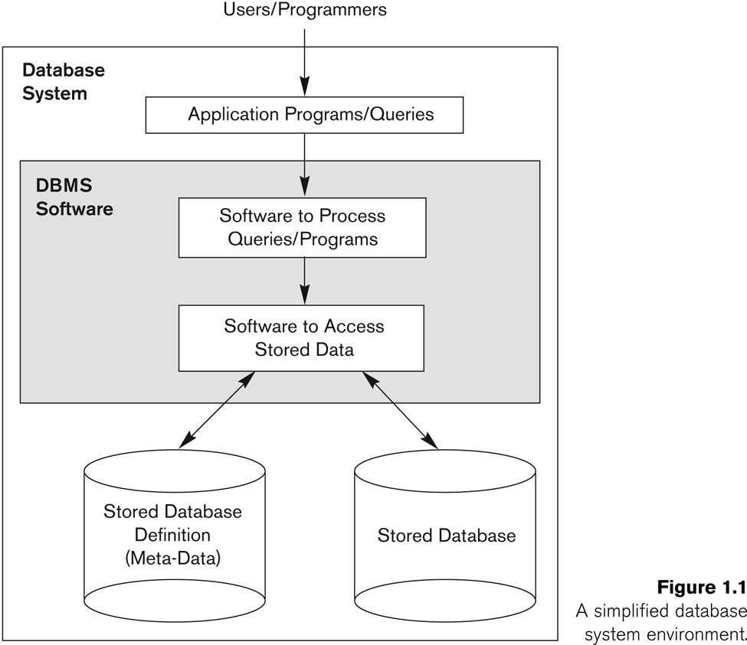
Summary
Database & Database Users
Characteristics of DB Approach
Self-describing
Data Abstraction (insulation between program & Data)
Support of Multiple Views of Data
Sharing of Data and Multiuser transaction processing (OLTP)
Actors on the Scene
Database Administrator/Database Designer/End Users/Software Analysts and
Application Programmers
Advantages of DB Approach
Controlling Redundancy
Restricting Unauthorized Access
Providing Persistent Storage for Program Objects
Efficient Storage and Query Processing
Providing Backup & Recovery
Providing Multiple User Interface
Representing Complex Relationships among data
Enforcing Integrity Constraints
Economies of Scale

Slide 18
Any question????

